Slide 1
Growth and texturing of rare earth nitride thin films
Q2.3 MRS
26 November 2007

Slide 2
Victoria University of Wellington
Ben Ruck
Jianping Zhong
Claire Meyer (Q10.6)
Joe Trodahl
Canterbury University (PLD)
Steve Durbin
Ian Farrell

Slide 3
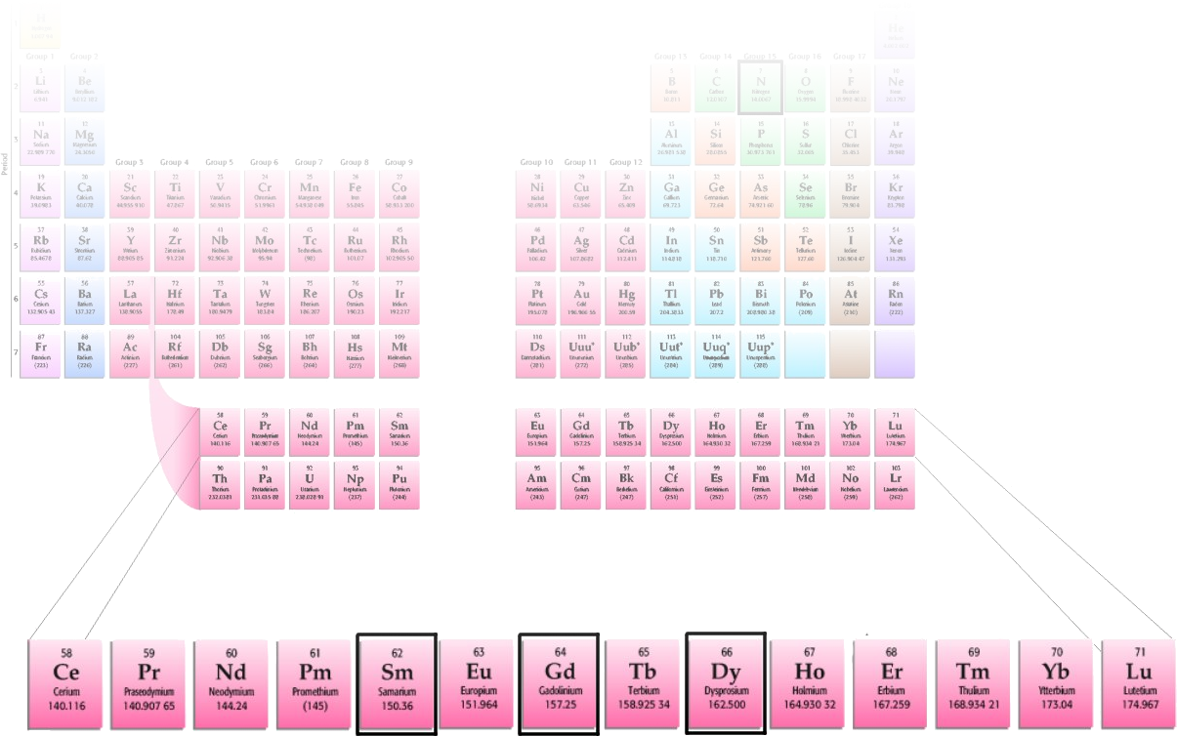
Rare earth nitrides
Across the RE series you get very…
  similar chemical properties (5d and 6s electrons)
  different magnetic properties (unfilled 4f shell)
All have simple cubic rock salt (NaCl) structure
React with water in atmosphere
  Need to passivate with capping layer

Slide 4
Rare earth nitrides
Interesting questions
  Electronic structure calculations are challenging
    localized 4f electrons are tough to deal with
    Many different predictions
    Metallic, half-metallic and semi-conducting states predicted
  Magnetic ordering
    SmN magnetism
      Small magnetic moment, magnetic ordering
      see Claire Meyer Q10.6
Very clear need for experimental results

Slide 5
Growth methods
MBE
  Gerlach et al, Appl. Phys. Lett. 90, 061919 (2007)
RE(NH₂)₂ -> REN
  Imamura et al, J. All. Comp. 16169 (2007)
Reactive Ion-Beam sputtering
  Leuenberger et al, PRB 72, 014427 (2005)
Thermal evaporation (VUW)
  Granville et al, PRB 73, 235335 (2006)

Slide 6
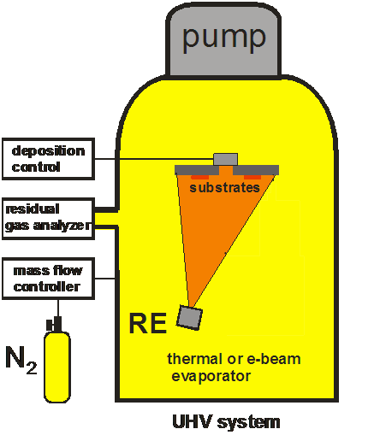
Thermal evaporation
UHV
Partial pressure of N₂
gas
  P_{N2} ~ 10⁻⁴mbar
This works!
GaN or MgF₂
capping layer
Notes:
Note: elevated temperature not explored yet.

Slide 7
Characterization
SmN, GdN, DyN, ErN, LuN
Good 1:1 stoichiometry ± 2% (RBS)
Low O content, uniform films (SIMS)
Semiconducting (transport)

Slide 8
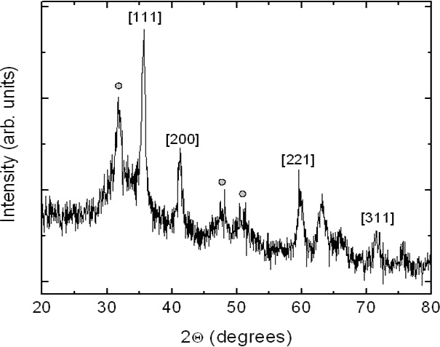
Characterization - XRD
SmN
Typical REN
Randomly oriented
nanocrystals
(~10nm)

Slide 9
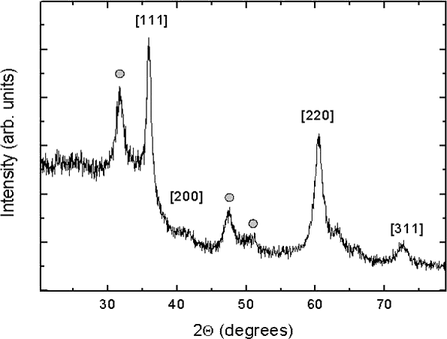
Characterization - XRD
GdN (!) SmN

Slide 10
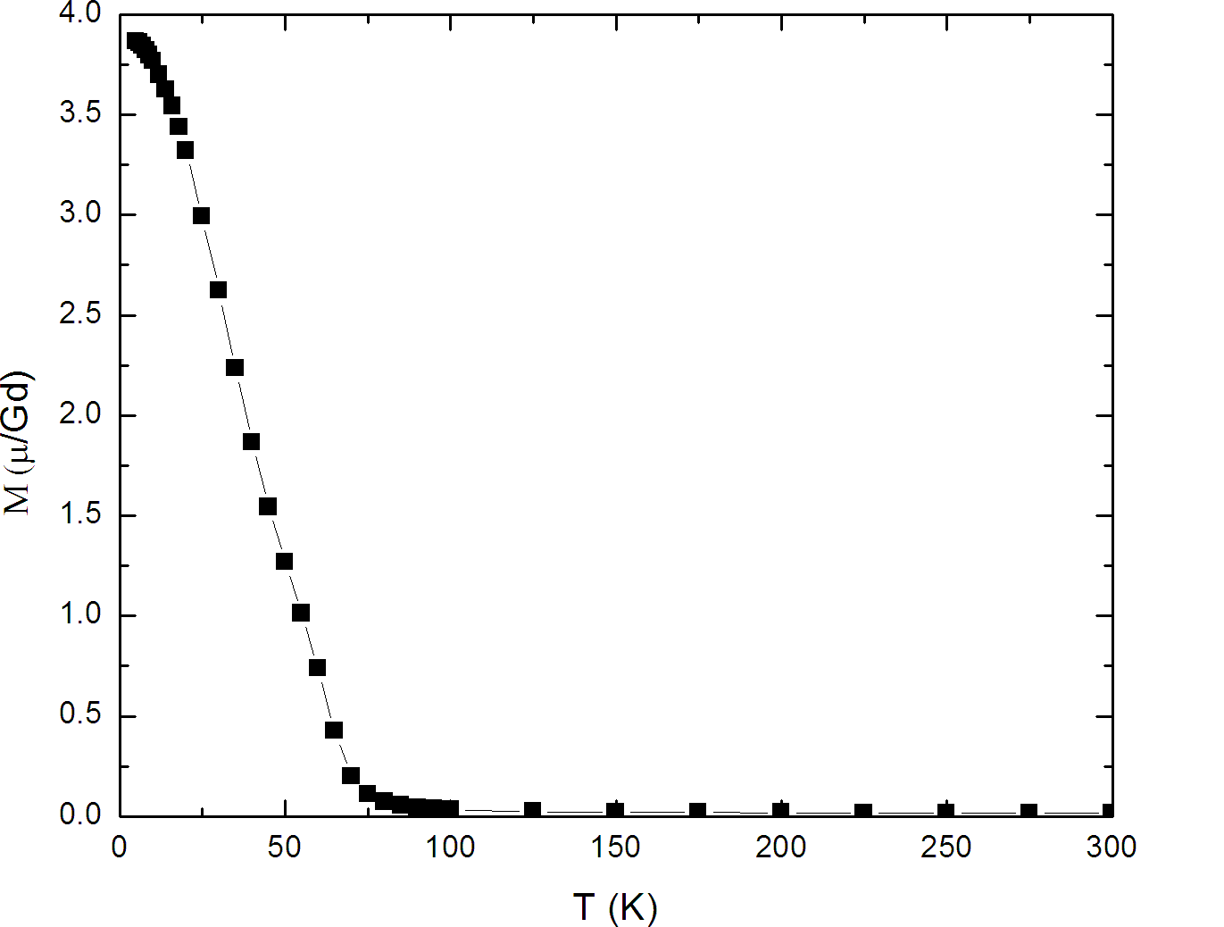
Characterization
Clear magnetic transitions (GdN: 70K)
Coercive field ~ 250 Oe
Granville et al, “Semiconducting ground state of GdN thin films” Phys. Rev. B, 73, 235335 (2006)

Slide 11
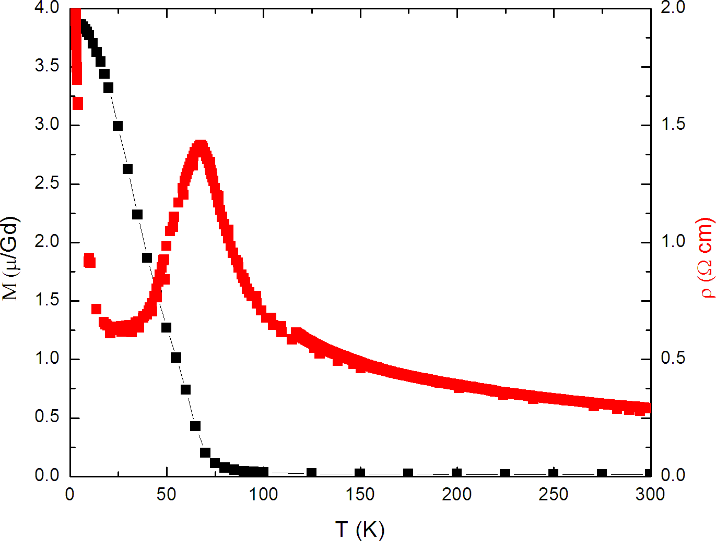
Characterization
Semiconducting behaviour
  smaller gap in ferromagnetic ground state
Granville et al, “Semiconducting ground state of GdN thin films” Phys. Rev. B, 73, 235335 (2006)

Slide 12
Pulsed Laser Deposition (PLD)
Laser ablation of RE metal source
Similar to thermal evaporation techniques except that evaporation rate is time dependant (depends on pulse frequency)
Main advantages
  Can grow at elevated temperature
  Novel capping materials possible
  RHEED for in situ characterization

Slide 13
PLD - GdN
Have grown thin films of GdN
At elevated temperatures: ~700°C
Substrates: Si, Sapphire, YSZ
Capping layer: YSZ

Slide 14
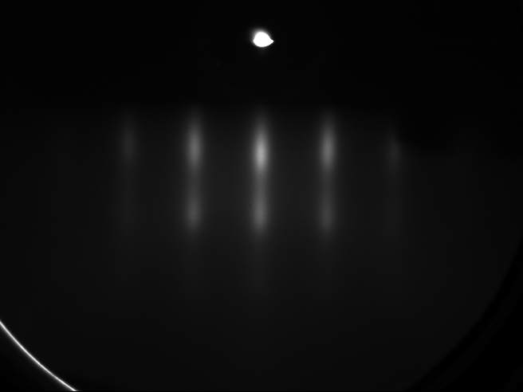
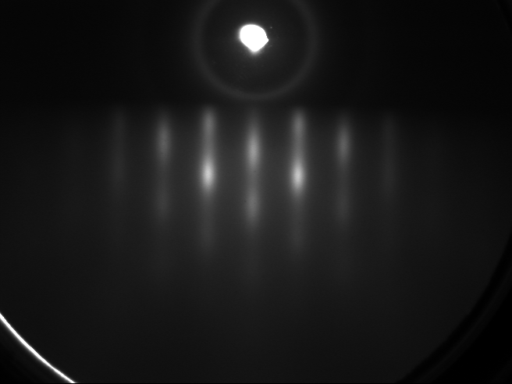
Characterization - RHEED
RHEED taken along 2 different directions
  Match RHEED of substrates (in-plane epitaxy)

Slide 15
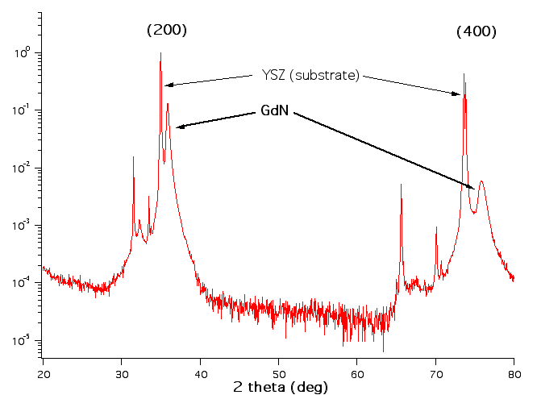
Characterization - XRD

Slide 16
Characterization - Magnetic
Magnetization saturates at very small field strengths
Coercive field ~ 20 Oe
  Order of magnitude smaller than thermal samples

Slide 17
Many parameters to explore
Rare earths
Substrates
  Si
  YSZ (lattice matched, but oxygen is a worry)
  Sapphire
Growth temperature
Growth pressure
Activated N₂
Capping layers

Slide 18
Summary
Both theory and measurements of nanocrystalline films indicate interesting properties
Further advances require quality epitaxial films before they can be answered
This has been achieved as a proof of concept
Much more work to do

Slide 19
Thank You
Claire Meyer (Q10.6)
Magnetic properties of REN thin films

Slide 20
Appendix

Slide 21
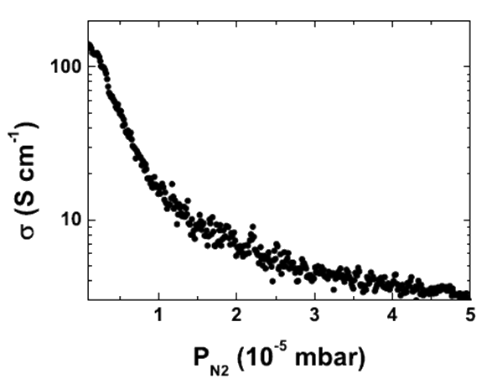
Extra Info - N₂ Pressure

Slide 22
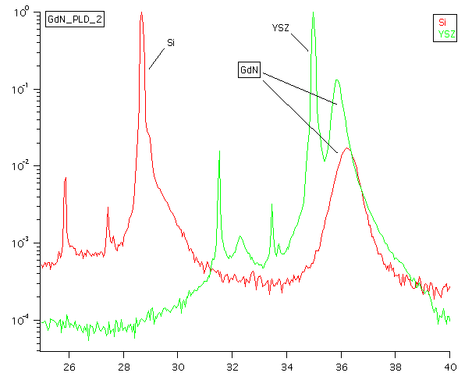
Extra Info - PLD XRD

Slide 23
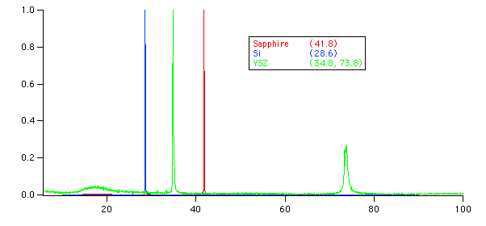
Extra Info – Substrates

Slide 24
Extra Info – RBS

Slide 25
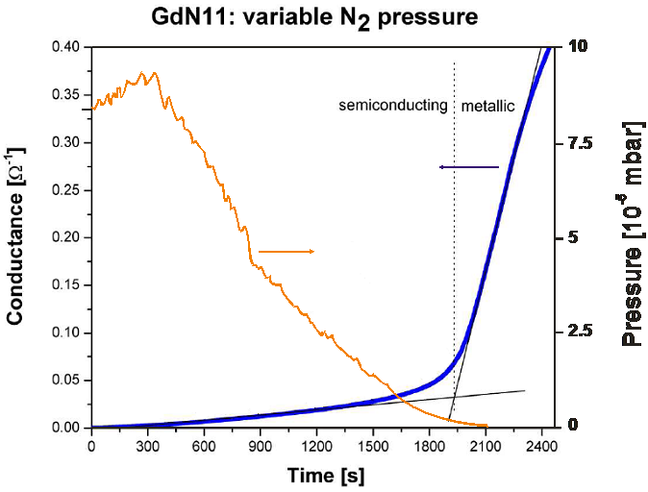
Extra Info – N₂ content

Slide 26
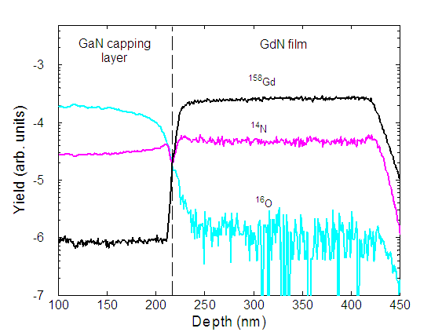
Extra Info – SIMS profile
N₂ GdN (GaN cap)

